Slide 1
Texas Business Courts and the Fifteenth Court of Appeals
Fifth District Court of Appeals
Justice Bill Pedersen III
Justice Dennise Garcia
Jamaria Rongey, Law Clerk

Slide 2
A Major Change to the Texas Business Litigation Landscape
House Bill 19 (88R): effective September 1, 2023
Applies to civil actions filed on or after September 1, 2024
Texas joins many other states in having a specialized court or docket for business-oriented or complex commercial litigation
But there are notable differences between the Texas business court and the business courts / commercial or complex dockets of other states

Slide 3
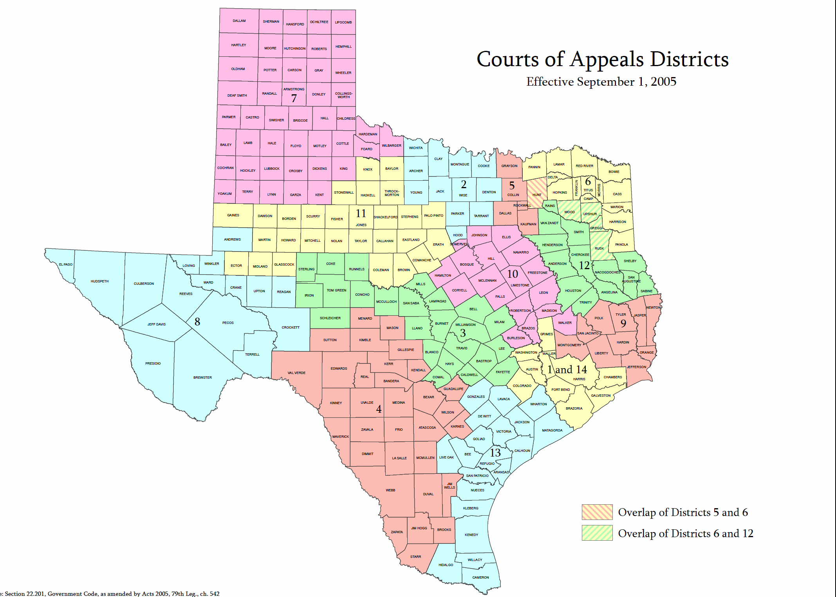
Appellate Courts
14 Districts
8

Slide 4
The Structure of the Court
Effectively, therefore:
Five divisions that are coming into existence now
Corresponding to the to the first, third, fourth, eighth, and eleventh administrative judicial regions
Six divisions not yet in existence, and whose future existence is uncertain
Corresponding to the to the second, fifth, sixth, seventh, ninth, and tenth administrative judicial regions

Slide 5
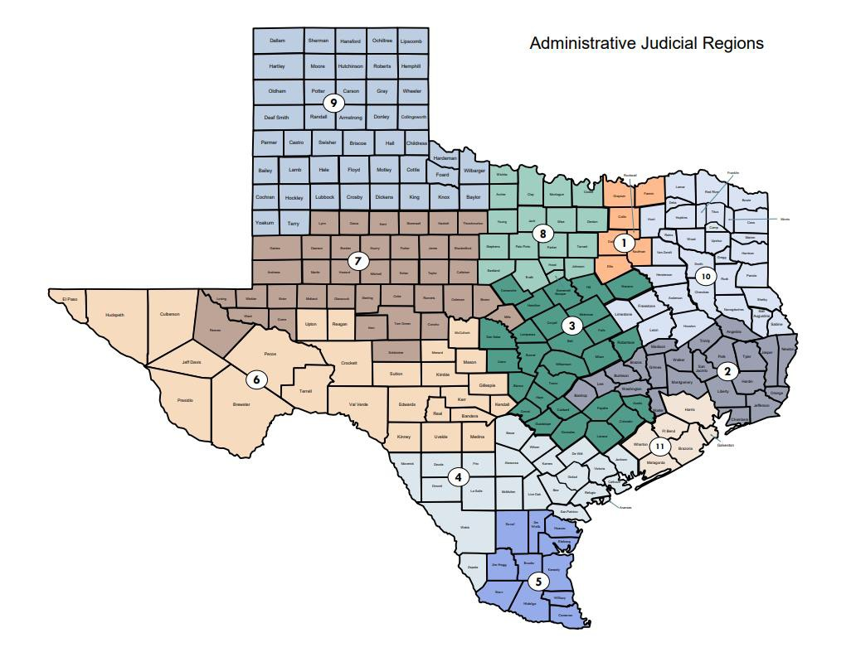
The Structure of the Court
Business court divisions are established in the 1st (Dallas), 3rd (Austin), 4th (San Antonio), 8th (Fort Worth), and 11th (Houston) Administrative Judicial Regions
https://www.txcourts.gov/media/1453885/ajr-map-2017.pdf
8

Slide 6
Judges
Requirements for judges on the business court:
At least 35 years old, a United States citizen
A resident of a county within the division for at least five years
A licensed attorney in Texas with ten or more years of experience in:
Practicing complex civil business litigation;
Practicing business transaction law;
Serving as a judge on a civil court; or
Some combination of these

Slide 7
The Logistics of the Court
Logistics:
Business court judges will select an administrative presiding judge for the business court by majority vote
The administrative presiding judge will appoint a clerk, whose offices will be in Travis County. The clerk shall accept filings
Judges will maintain chambers in a county selected by the judge, within the division to which the judge is appointed
Court may be held at any courtroom within the division
Judges may order remote proceedings (other than for jury trials; and if oral testimony is taken in a hearing, all parties must consent)
Business court judges may exchange benches and sit for one another

Slide 8
Jury Trials for the Court
Jury Trials:
County of jury trial will be announced after establishment of jurisdiction and venue
If case filed initially in the business court, plaintiff may choose county of jury trial, provided venue is proper in that county
If a case was removed, jury trial will be held in county in which action was originally filed (provided venue is proper)
Procedures regarding jury panels, jury selection, and other jury-related procedure shall mirror that of the district court in the county in which the trial is held

Slide 9
Jurisdiction of the Business Court
Concurrent Jurisdiction with District Courts
The $5 million (or publicly traded company) category
The $10 million
category
Declaratory or injunctive relief involving a dispute in one of above categories
But No Jurisdiction Over Certain Cases / Claims Unless Supplemental
Supplemental jurisdiction must be agreed to by all parties and judge
List of categories of cases
No Jurisdiction at All, Not
Even Supplemental
Medical liability claims
Claims seeking recovery of monetary damages for bodily injury or death
Supplemental Jurisdiction
Applies to claims that are part of same case / controversy; must be agreed
Legal malpractice claims

Slide 10
Jurisdiction: The $5 Million Category
Derivative actions •
Actions seeking to hold an owner or governing person liable for obligation of the organization (veil-piercing)
Actions regarding governance of a business organization
Certain actions by a business organization or
owner against an owner / controlling person
/ managing official of the organization re: acts or omissions
State or federal securities or trade
regulation claims against certain parties
Actions arising from Business
Organizations Code
Actions alleging that an owner / controlling person / managing official breached a duty to organization or owner
Note: these cases are within the Business Court’s jurisdiction regardless of amount in controversy if a publicly trade company is a party to the action

Slide 11
Jurisdiction: The $10 Million Category
Actions arising from a contract or transaction in which the parties agreed to the jurisdiction of the business court (except an action that arises out of an insurance contract)
Actions arising out of a violation of the Finance Code or Business & Commerce Code by an organization or officer or governing person (excluding banks, credit unions, and savings and loans)
Actions arising out of a “qualified transaction”

Slide 12
Qualified Transaction
"Qualified transaction" means a transaction, other than a
transaction involving a loan or an advance of money or credit by a bank, credit union, or savings and loan institution, under which a party:
pays or receives, or is obligated to pay or is entitled to receive, consideration with an aggregate value of at least $10 million; or
lends, advances, borrows, receives, is obligated to lend or
advance, or is entitled to borrow or receive money or credit with an
aggregate value of at least $10 million.

Slide 13
Excluded from Jurisdiction, Unless Supplemental
Actions brought by or against a • Texas Antitrust Act claims
governmental entity
DTPA claims
Foreclosures on a lien or real or personal
property
Claims arising from the Insurance Code
Claims arising from Title 9 Property Code (related to trusts) Trusts related matters
Claims related to the duties and obligations under an insurance policy
Claims arising from the Estates Code or Family Code
Claims related to a consumer transaction
Claims arising out of the production or
sale of a farm product
Claims related to mechanic’s,
contractor’s, materialman’s liens
Exercise of supplemental jurisdiction requires agreement of all parties and the court – see next slide

Slide 14
Excluded from Jurisdiction Entirely
Medical liability claims
Claims seeking recovery of monetary damages for bodily injury or death
Legal malpractice claims

Slide 15
To Be Determined
Actual application of jurisdictional rules to a variety of cases and claims
Will the amount-in-controversy requirements force parties to specify damages numbers early in the case?
If a plaintiff seeks to avoid the business court on grounds that the amount in controversy is not met, will a binding stipulation be required? If so, will it also be sufficient?

Slide 16
Venue, Removal, and Transfer
Parties may file actions directly in the business court (venue must be proper in a county in the business court division)
Actions filed in district or county court that are within the business
court’s jurisdiction are removable to the business court
However, a party may not remove to the business court an action filed in a district or county court of proper venue that is not within an operating division of the business court
If the business court is found to lack jurisdiction, it may transfer or remand the action to a proper district or county court

Slide 17
Appeals
Appeals of judgments and orders of the business court will go to the newly created Fifteenth Court of Appeals
The Fifteenth Court will have five justices elected statewide (three justices for the first three years)
It will have statewide jurisdiction over appeals involving:
Matters brought by or against a state entity (with certain exceptions)
Matters in which a party challenges the constitutionality or validity of a state statute or rule, and the attorney general is a party to the case
Appeals from the business court

Slide 18
Concluding Thoughts and Questions

